Slide 1


Prepared by group 1
Online Examination
System
6 JUL, 2025

Slide 2
Team Members
Hajer Emad
Rosana Hossam
Radwa Mohamed
Mohamed Shaban
Abdallah Foad

Slide 3
Introduction
Project Objectives
System Components
Project phases
Tools used
Data Generation
Stored Procedures
Reports
Power BI Dashboards
Web Application
Desktop Application
Problems we have faced
Conclusions
Agenda

Slide 4
Introduction
Online examination systems have become a widely adopted method due to their time efficiency, accuracy, and ability to accommodate large number of participants. They provide clear instructions and guidelines, ensuring better student understanding. Particularly in technical education, basic knowledge of online examination systems is essential. Entrance exams are increasingly conducted online for their fast and precise evaluation, it is necessary for every technical student to have basic knowledge of online examination system

Slide 5
Project Objectives
Build a secure and efficient online examination system
Automate exam creation and correction
Provide clear reports and dashboards for analysis
Support both web and desktop access
Ensure role-based user access
.

Slide 6

System Components
Database Management System (SSMS).
Reporting Tools: SSRS, Power BI Reports.
Web Application + Desktop Application
Interface for Instructor: managing exam, questions, managing student data, grades, creating exams, managing courses and question bank.
Student Interface: taking exams and view analysis about student performance and grads.

Slide 7
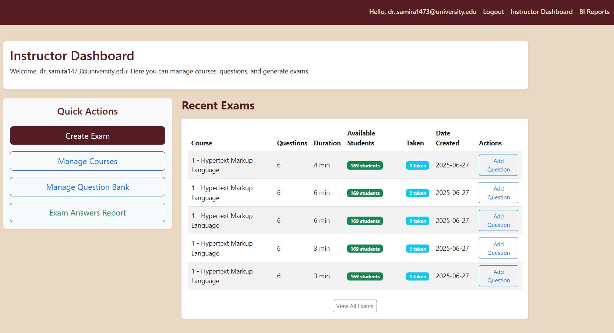

Slide 8
We have built our project on a set of steps to get it done
Analyzing the Idea
Get data
Build the database and store data
Analyzing the data
Creating reports
Building the system
Test and validate the system
Project phases

Slide 9








Tools used
Team Connection
Used For Design ERD
Build Desktop app
Create SSRS Reports
Prepare GP Document
Build and designUsed For host database , execute queries
Team Meetings
Build and design Dashboards
Help in Generating data
Quickly Fixing bugs

Slide 10
Get Data

Slide 11

Data Generation
Tools used: Python library (Faker Lib)
We have generated a dataset contains 13 tables related to Educational and academic data, also we have managed the Data to fit our business model, also we have worked to Enhance the relatioships between the data tables

Slide 12
Data Generation
Class | Value
Number of students | 1000
Number of instructors | 12
Number of courses | 12
Number of exams | 108
Number Of Questions | 259

Slide 13
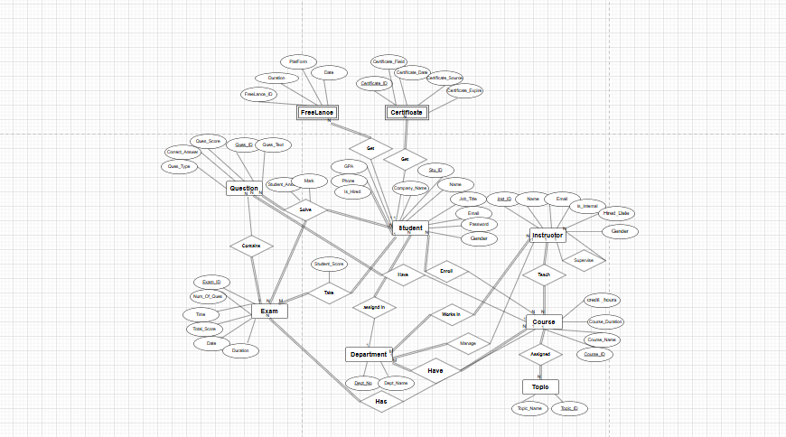
ERD

Slide 14
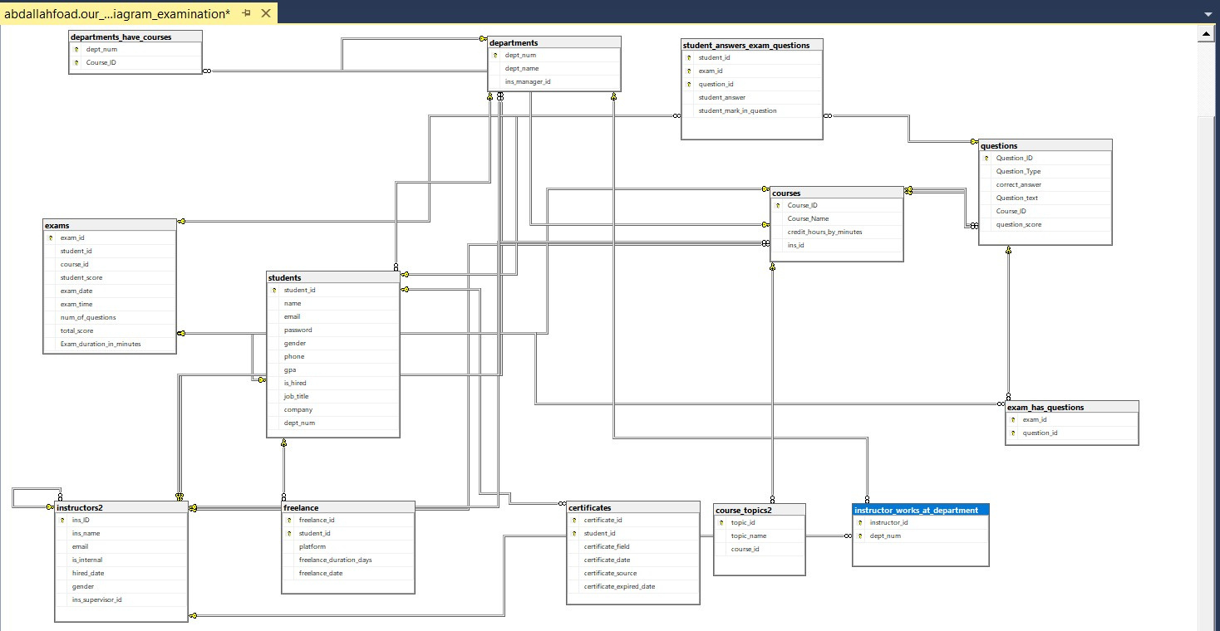
Mapping

Slide 15

Stored procedures
We have created a 50 stored procedures for inserting, updating
Delete and other operations on any tables.
Creating stored procedures for exam generation, answers,
And exam correction.
We creating Store Procedures for reproting and other tasks

Slide 16
Stored procedures
Stored procedures | description
Students By Department | Retrieves student details by department num
Student Exam Answers | Displays a student’s exam grades and percentage by student ID
Exam Questions | Fetches all questions and details for a given exam ID
Course Name and Student Counts by Ins id | takes an instructor ID, returns course names and student counts for their courses
Student Grades | takes a student ID and returns the exam ID, course name, student score, total score, and percentage for each exam taken, or an error if the student ID is invalid.
Topic Name | takes a course ID and returns the topic ID and topic name for each topic in that course

Slide 17
Reports
We utilize SSRS to generate the following reports:
Reprot providing student details based on Specified Department number parameter.
Report displaying the grades of a student across all courses, given the student id.
Report List of courses given by instrucotrs along with the number of students enrolled to each courses, Identified by Instructor id
Detailed Report Displaying Topic Names Associated with Each Course ID.
Report Listing All Question Texts Associated with Each Exam ID.
Report that displays Question id, Question Text, Correct answer, given exam id, student id.

Slide 18
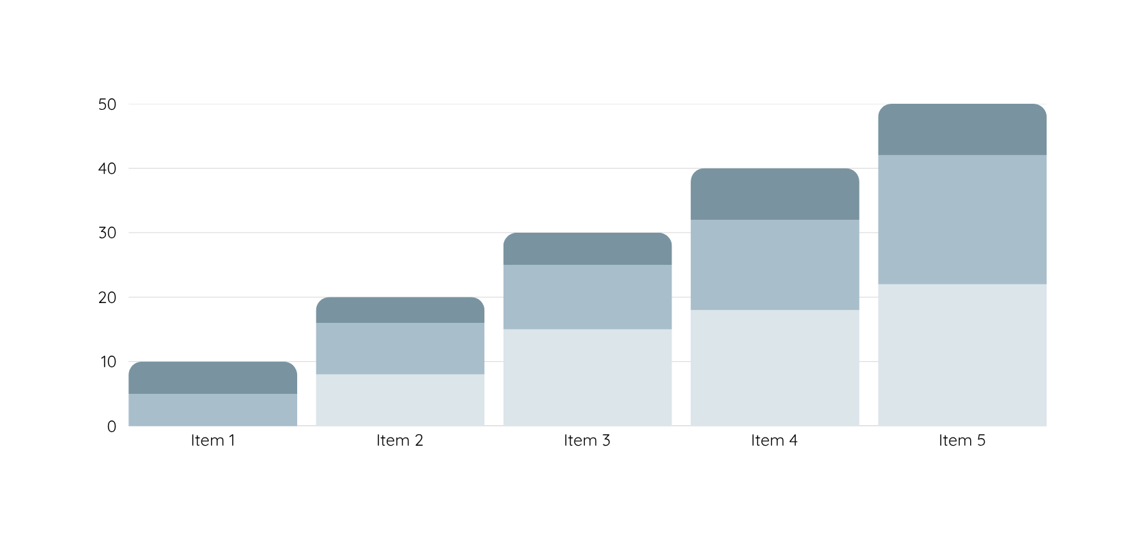
Reports

Slide 19
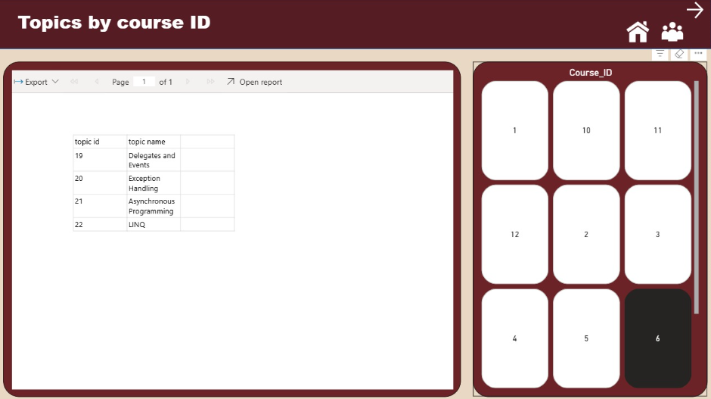

Slide 20
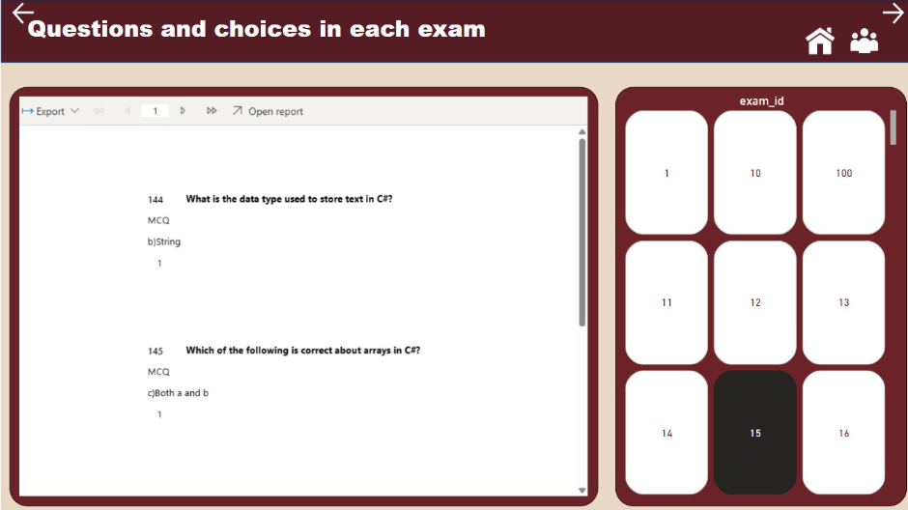

Slide 21
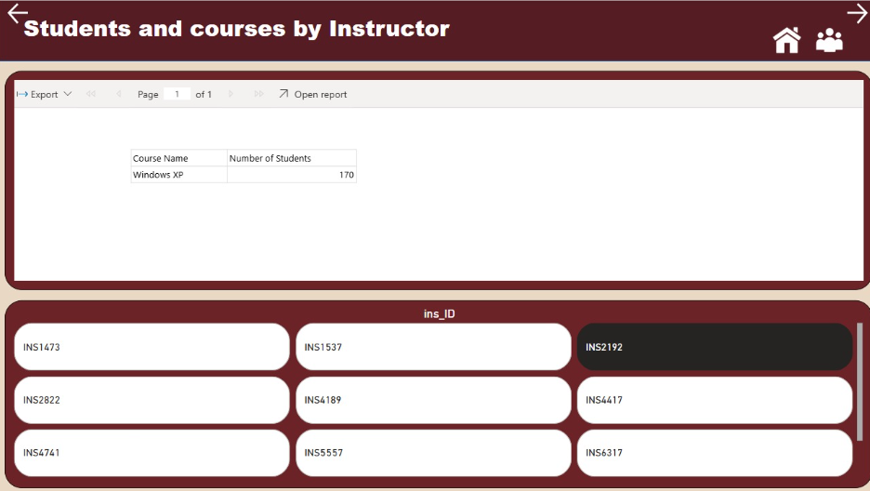

Slide 22
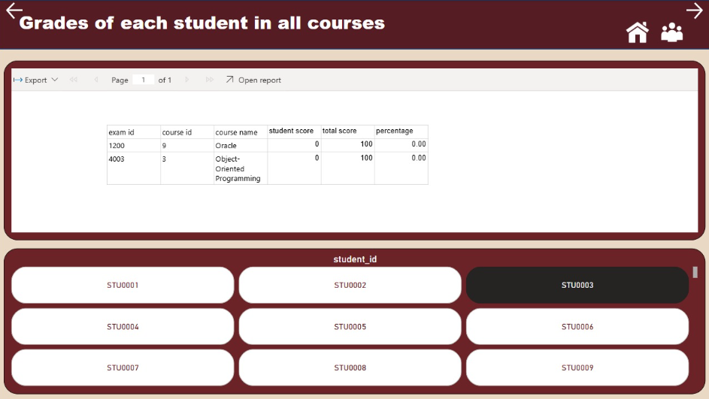

Slide 23
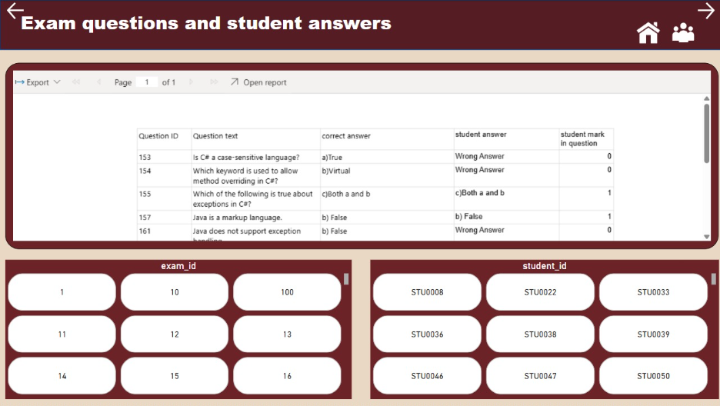

Slide 24
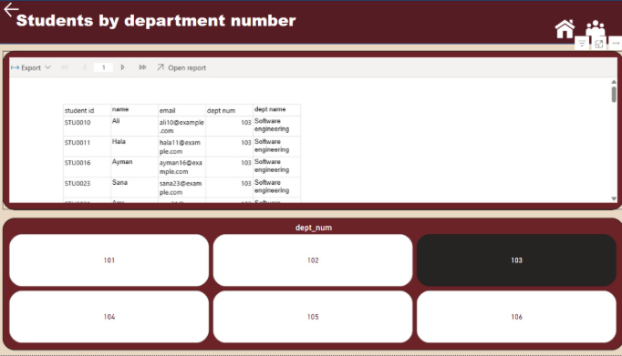

Slide 25
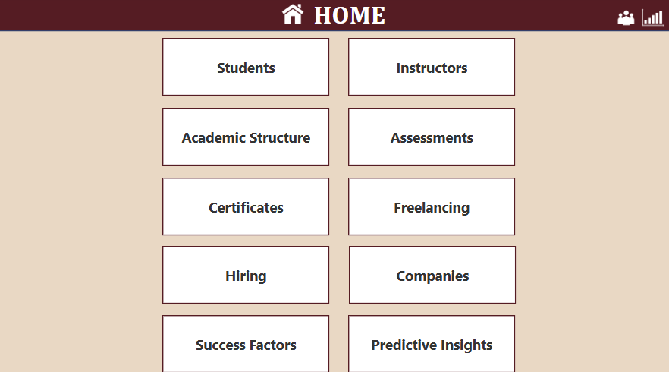
Power BI Dashboards
We have created power Bi reports for specific topics
Students
Instructors
Academic Structure
Assessments
Certificates
Freelancing
Hiring and Companies
Success factors
Predictive Insights

Slide 26
Dashboards Overview
We have created a set of power bi reports to serve our platform and to analyze the performance for students, instructors, exams, departments, also we provided a prediction reports to predict the percentage of succeeded students and its performance in each course.

Slide 27
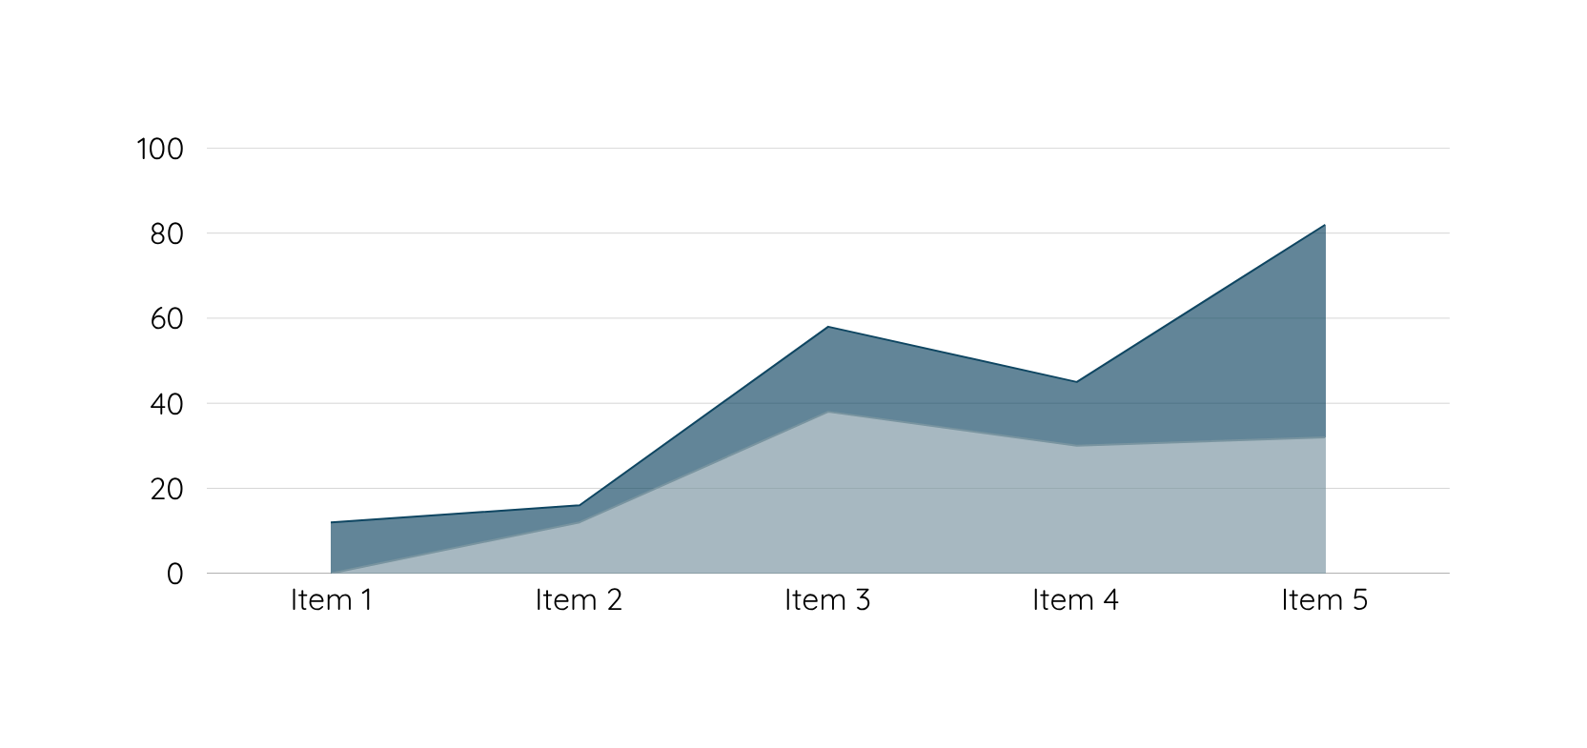
Power BI Dashboards

Slide 28
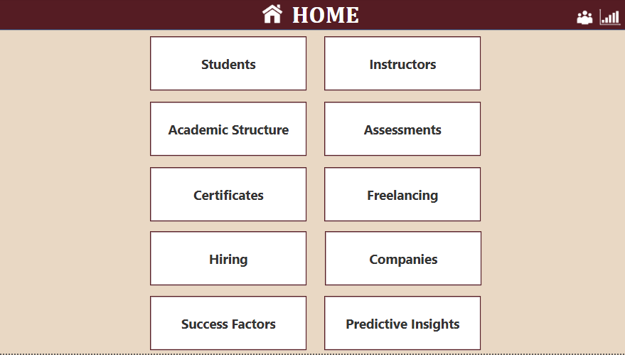

Slide 29
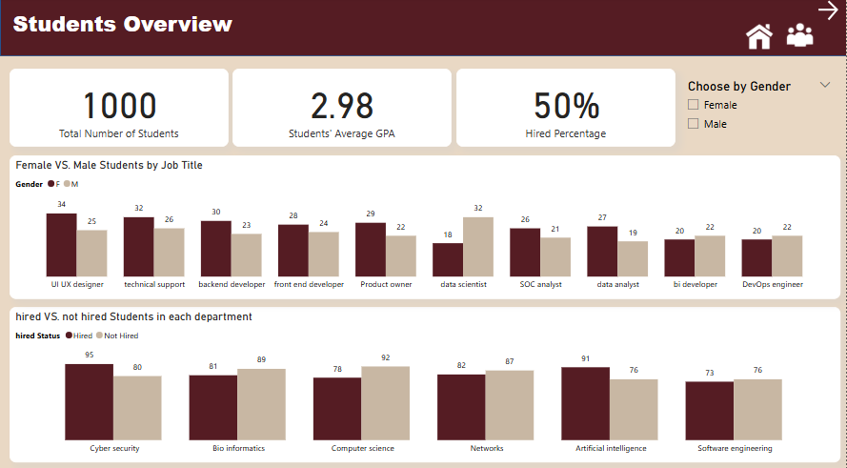

Slide 30
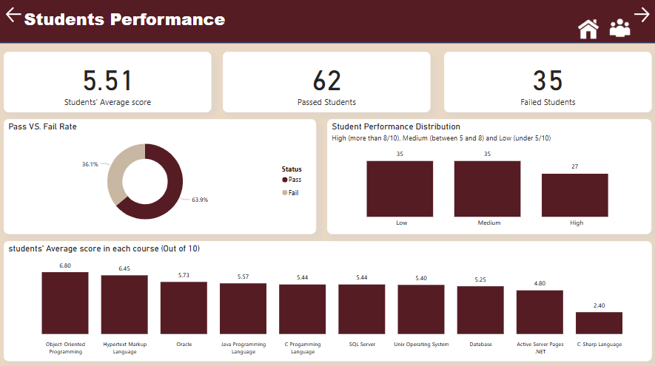

Slide 31
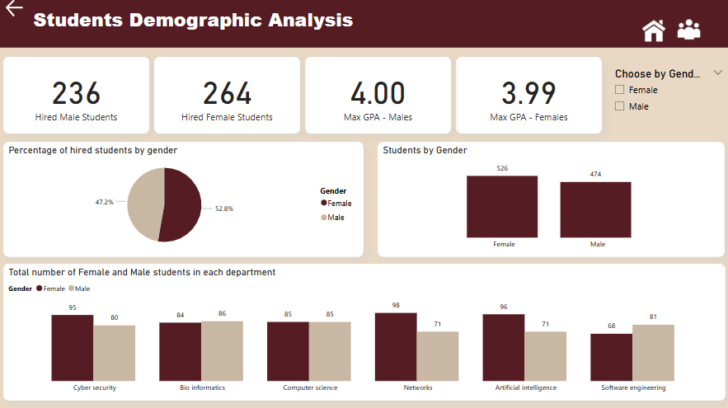

Slide 32
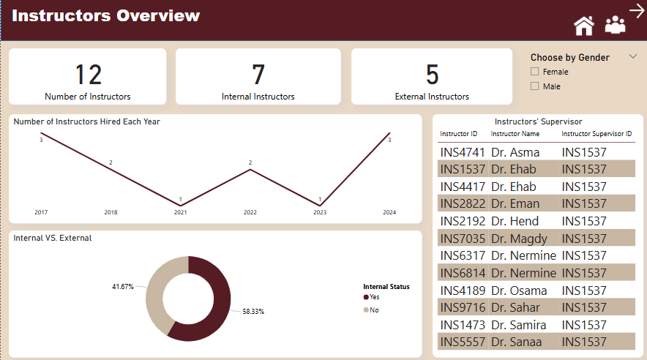

Slide 33
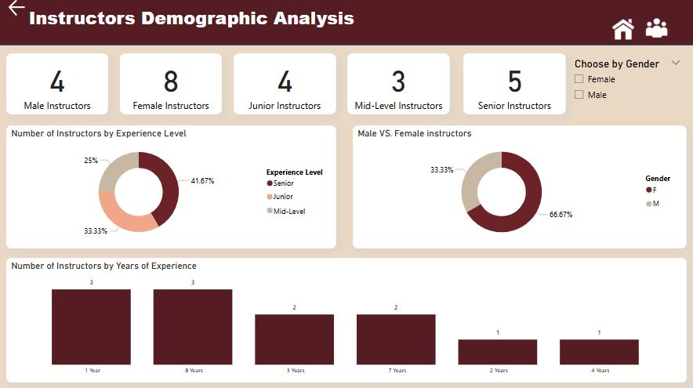

Slide 34
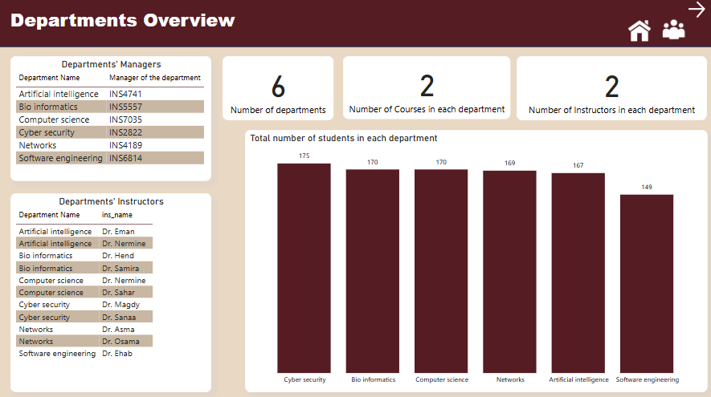

Slide 35
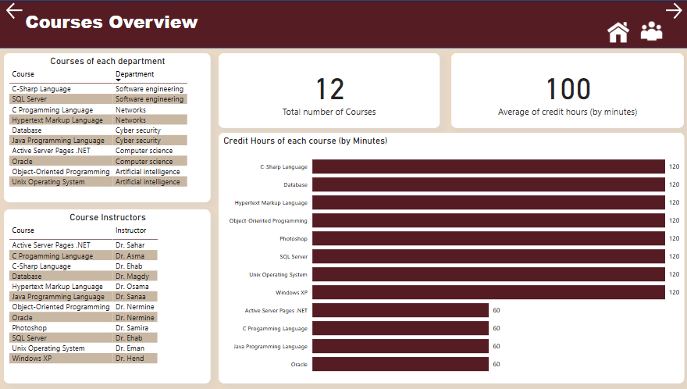

Slide 36
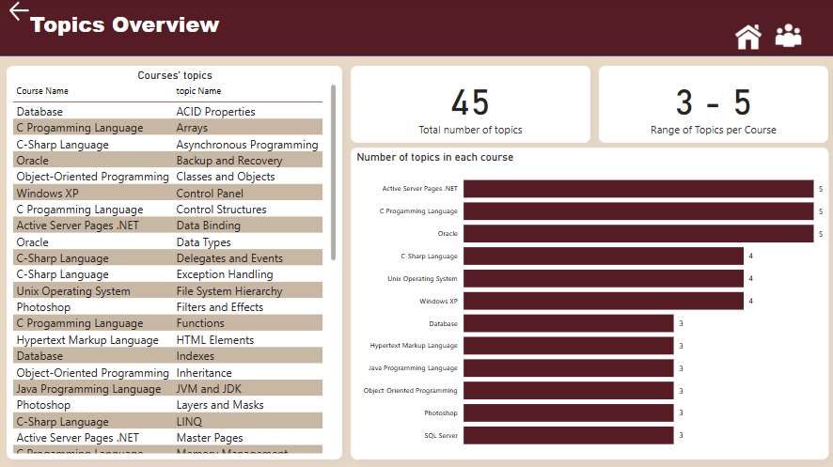

Slide 37
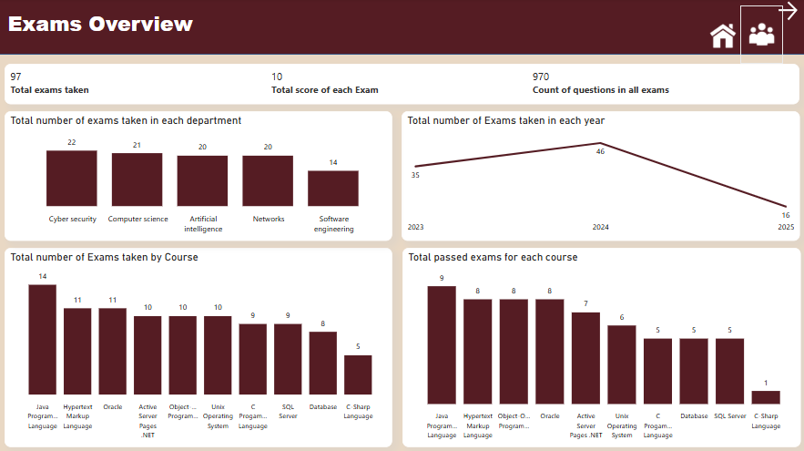

Slide 38
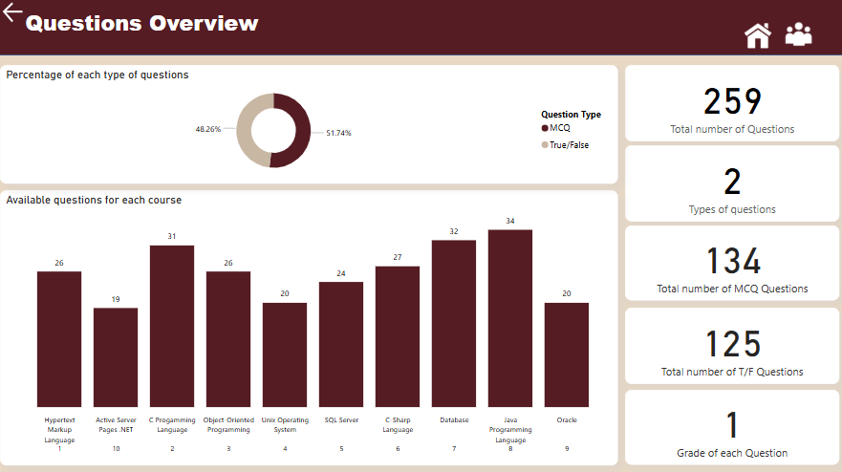

Slide 39
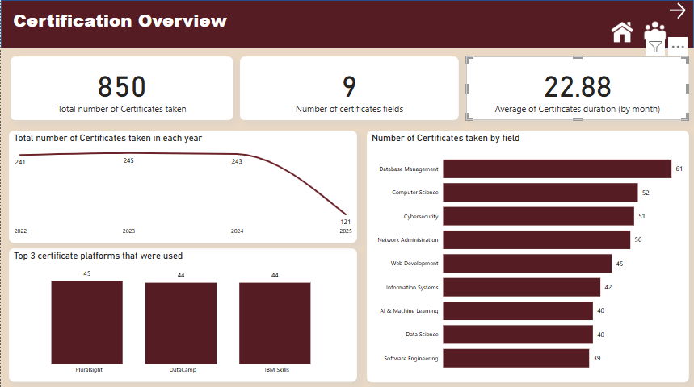

Slide 40
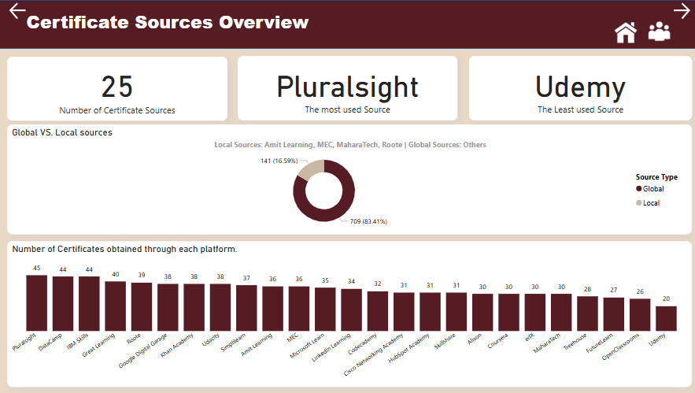

Slide 41
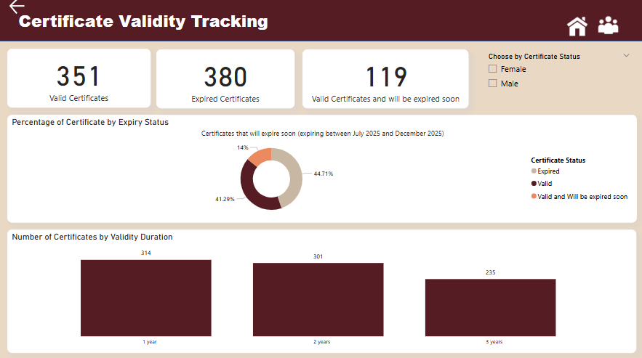

Slide 42
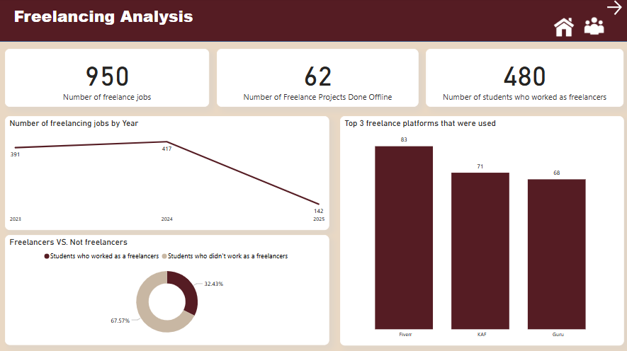

Slide 43
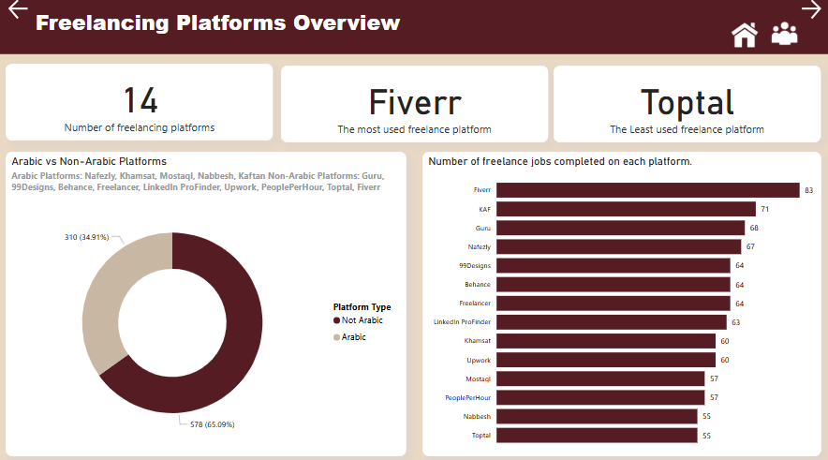

Slide 44
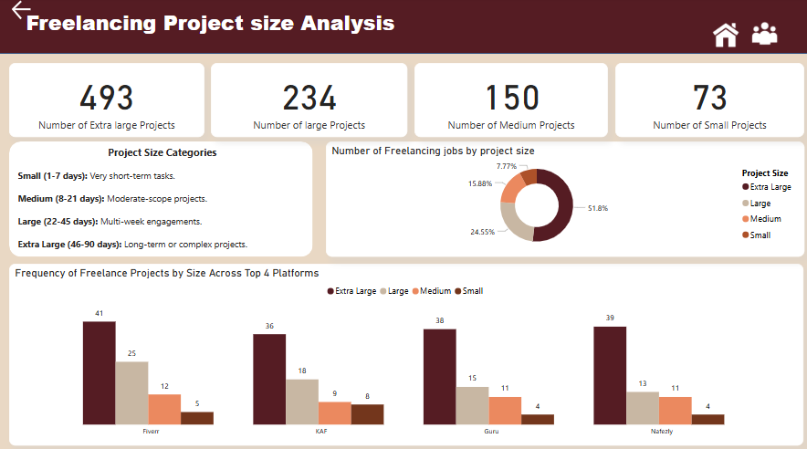

Slide 45
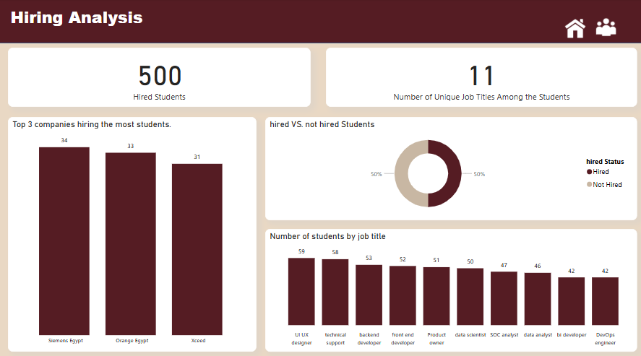

Slide 46
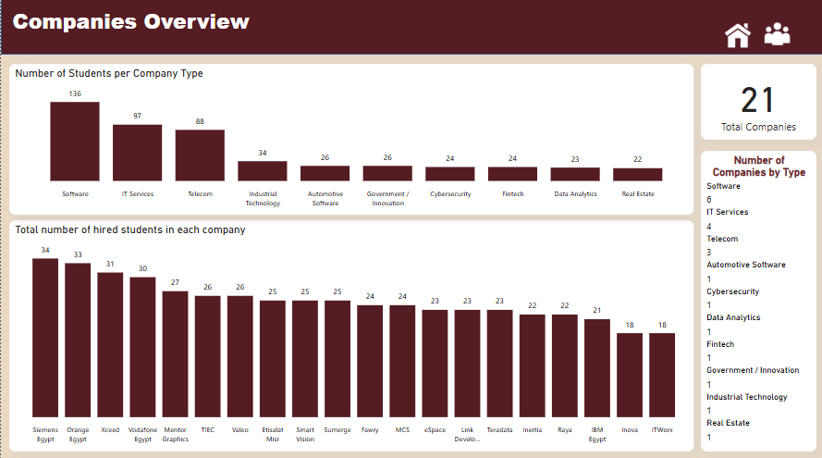

Slide 47
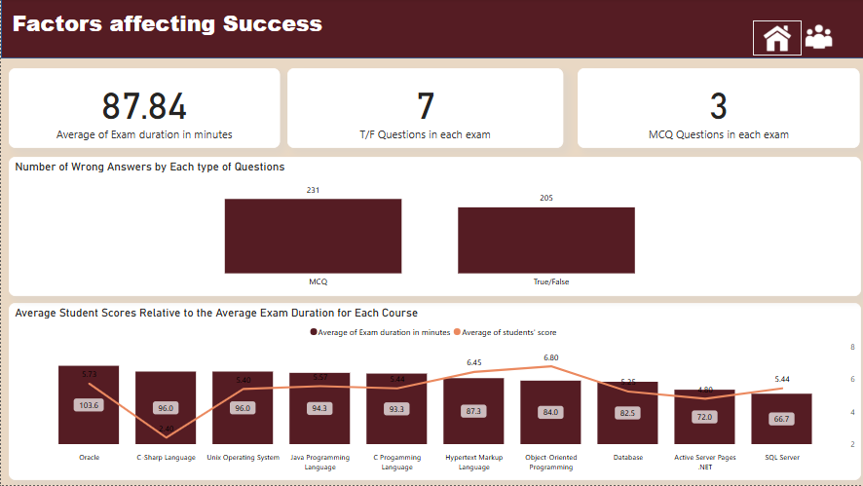

Slide 48
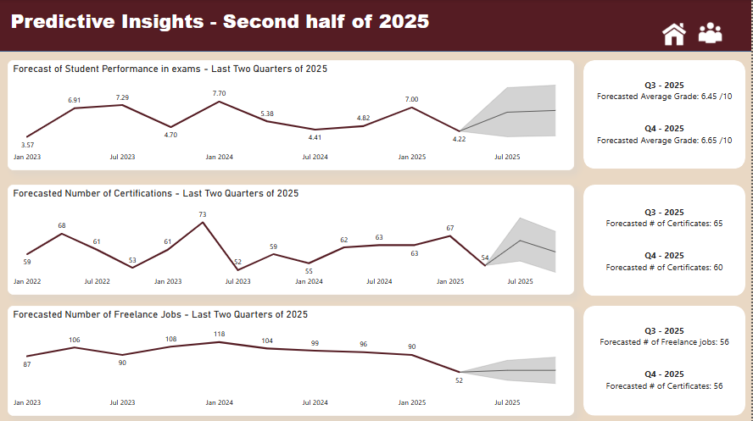

Slide 49
Web Application
We have created an online examination system to serve the student needs
And taking their exams and analysis about their grades, also we have
Created an interface for the instructors so they can generate exams and get
Insights and analysis for each student performance, we have linked the
Power bi reports and the database along with the web app to interact with
Each others across the system

Slide 50
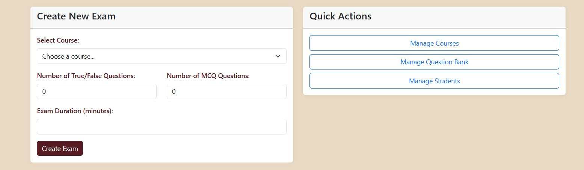
Web Application

Slide 51
Desktop Application

Slide 52
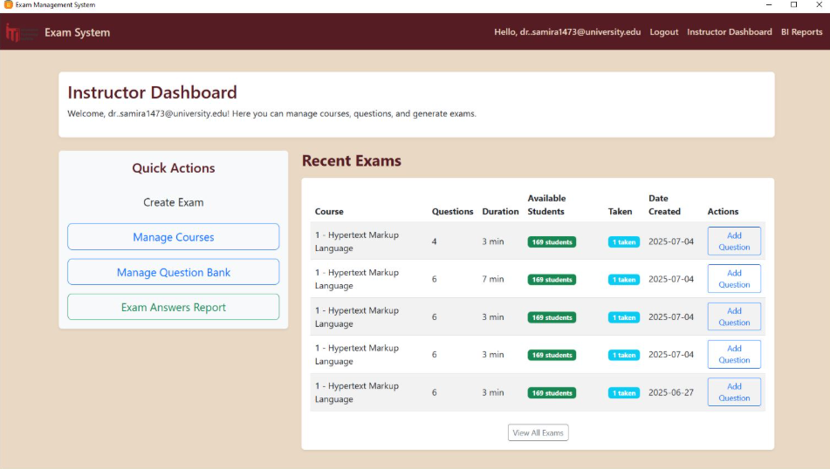

Slide 53
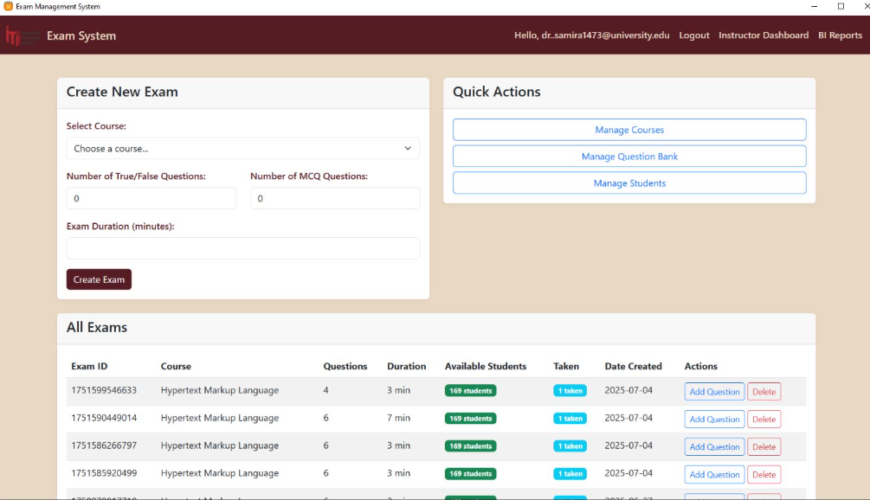

Slide 54
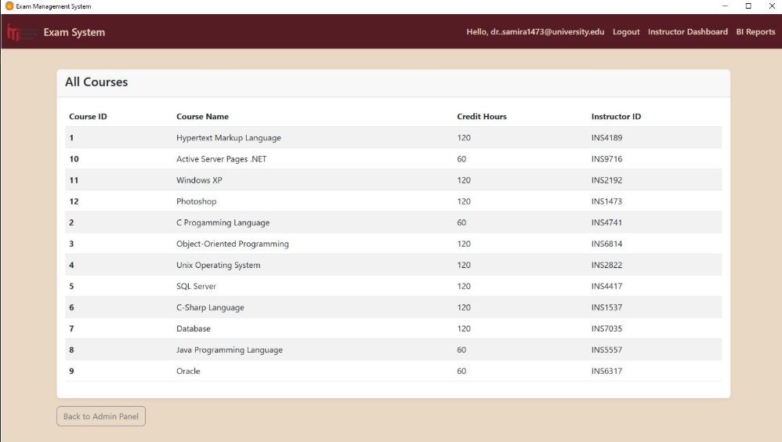

Slide 55
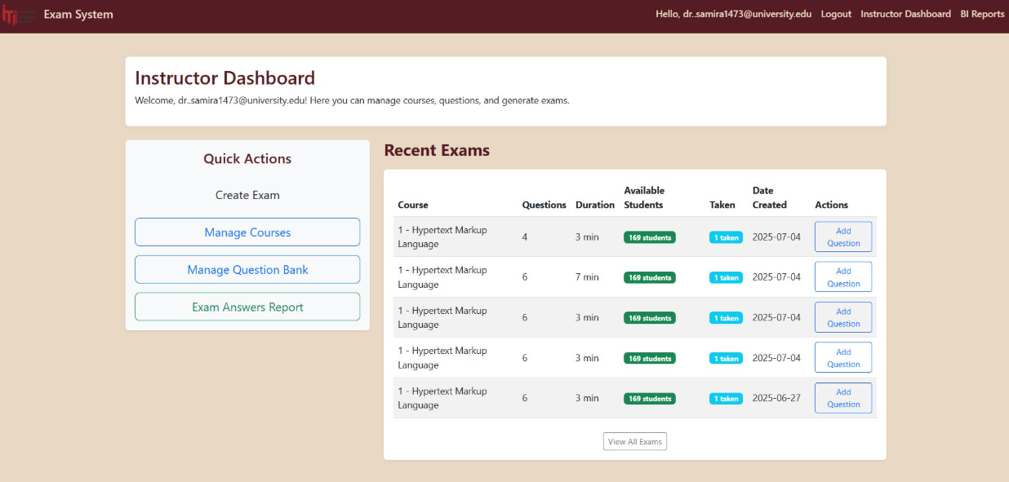

Slide 56
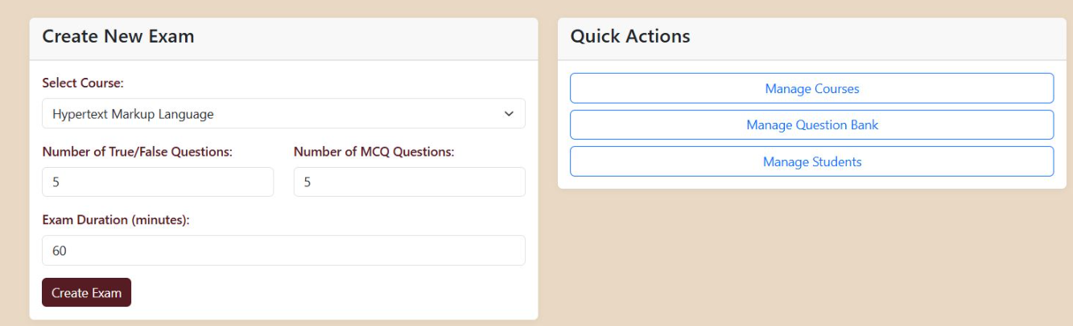

Slide 57
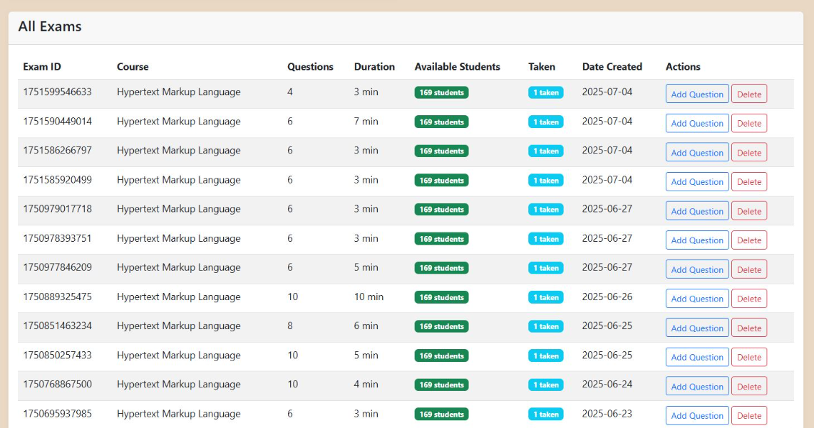

Slide 58
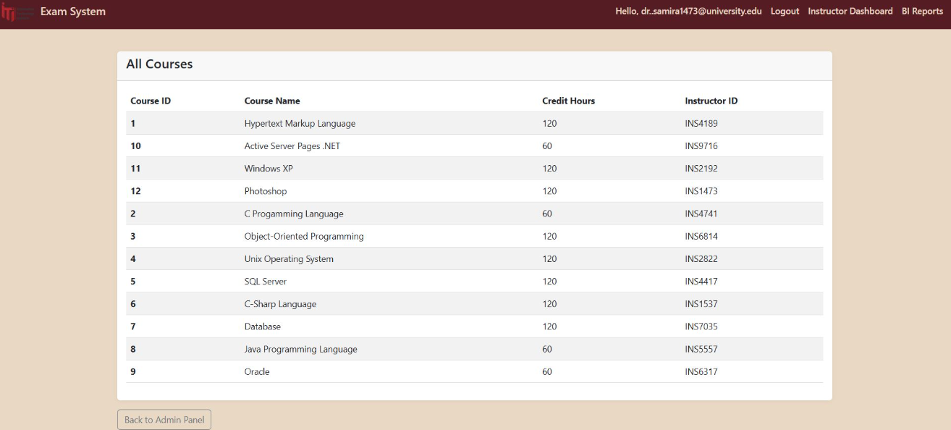

Slide 59
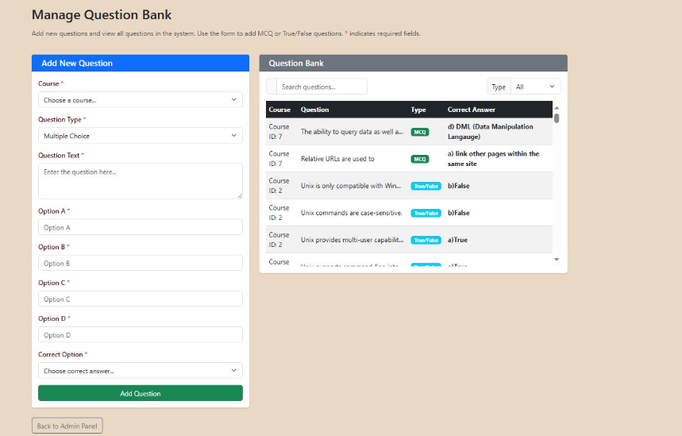

Slide 60
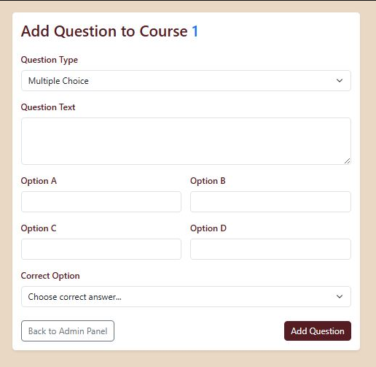

Slide 61
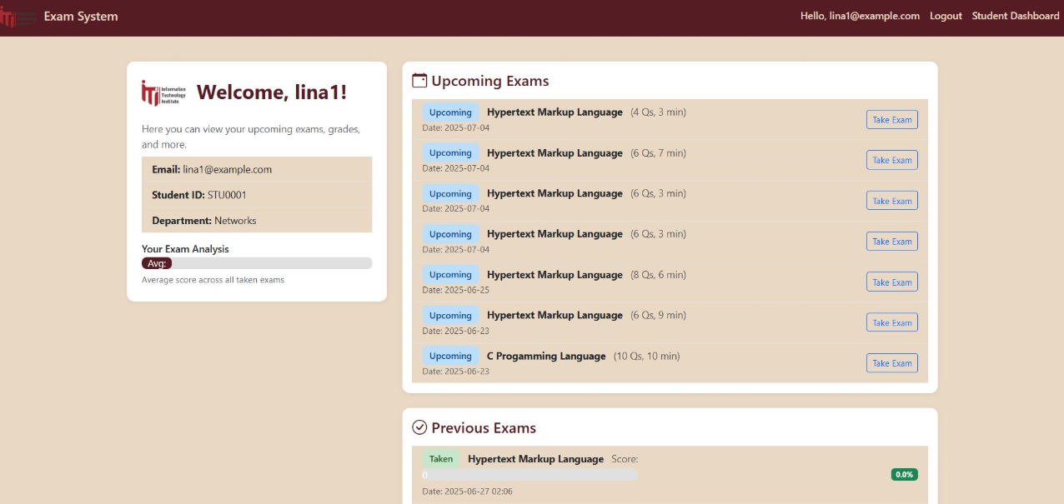

Slide 62
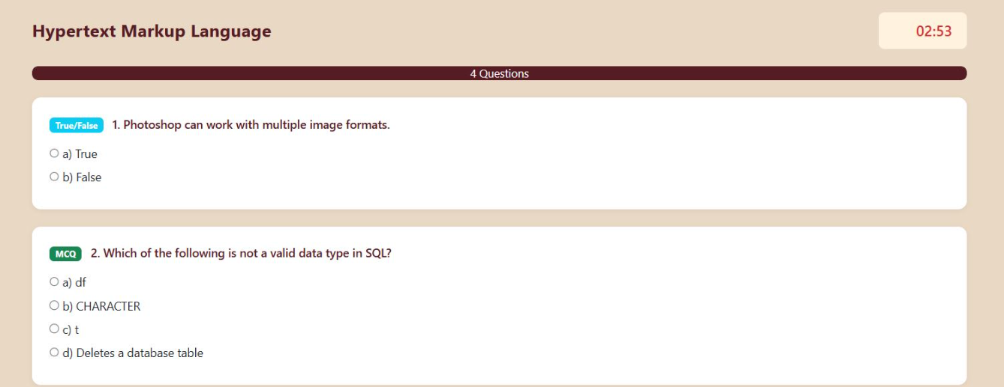

Slide 63
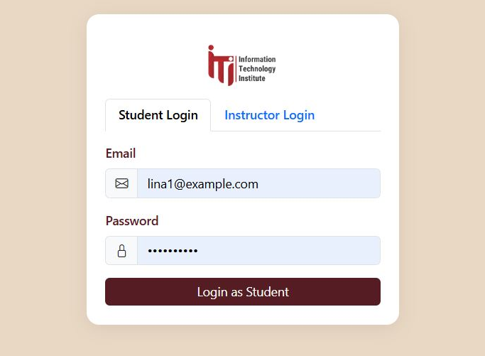

Slide 64
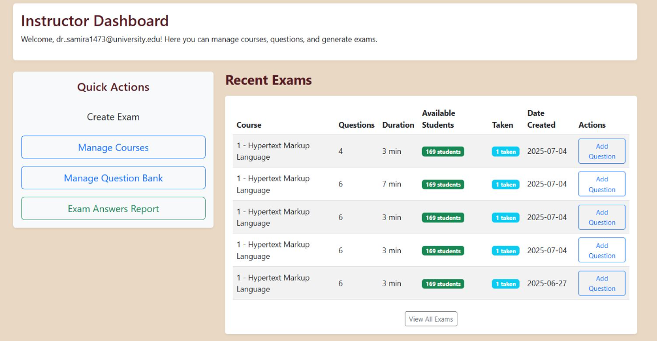

Slide 65
Problems we have faced
We have faced a problem that the data was not realistic and was not fit the model, also we have faced another problem that we collected data from different resources and that made the data unstable.
.
The Solution :
We have used python library (faker lib), it helped us to generate realistic and consistent data

Slide 66
Conclusion
The development and implementation of this online examination
system represent a significant stride towards modernizing and
streamlining the assessment process in education. By providing
a robust, intuitive platform for both students and instructors,
the system addresses many of the traditional challenges
associated with manual examinations, while introducing
numerous efficiencies and benefits.
Beyond the immediate conveniences, this online examination
system contributes to a more sustainable and technologically
integrated educational ecosystem. It reduces reliance on
paper, streamlines record-keeping, and enhances data
analytics capabilities for educational institutions, offering insights
into student performance trends and curriculum effecti

Slide 67
Thank you

